Slide 1


Drug Recommendation System Based on Patient-Described Symptoms
ICS5111 – Large Scale Data Mining
André Attard | Master of Science in Data Science | andre.attard.17@um.edu.mt
Francesca Marie Psaila | Master of Science in Data Science | francesca.psaila.17@um.edu.mt
5th February 2024

Slide 2
Identifying Problem and Corresponding Solution
The World Health Organisation (WHO) states that by 2030 there will be a shortage of 10 million health workers worldwide.
Two main problematic scenarios identified as a result of an overburdened healthcare system:
Health workers are more likely to make mistakes while treating patients.
Patients are more likely to self-medicate if unable to access medical resources.
How can data science lessen burden healthcare system?
System which utilizes a summary of patient symptoms to provide a disease diagnosis
Based on diagnosis a suitable medical treatment will be provided (Taking into account individual needs)
2

Slide 3
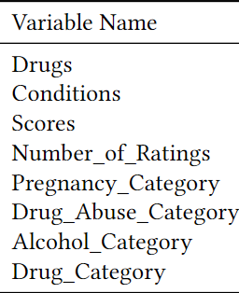
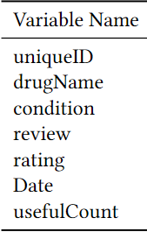
Data Sources
Two Data sets were utilised to develop a Proof of Concept (POC)
Structured Dataset
Obtained by manually scraping the Drugs.com website using Selenium Package.
Fifteen conditions were identified and for each condition all relevant treatments
were obtained.
Unstructured Dataset
Freely available on kaggle but originally published on the UCI Machine Learning
repository.
Variables of interest are patient reviews (review) and name of condition
(condition).
Conditions selected were restricted to the same fifteen conditions present in
structured dataset.
3

Slide 4
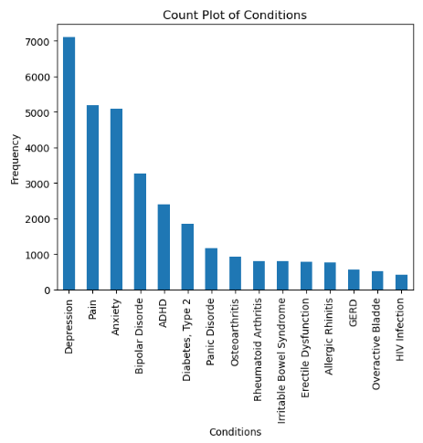
Initial Data Pre-Processing
The initial Pre-Processing pipeline for Unstructured dataset was as follows:
UniqueID, drugName, rating, Date and usefulCount columns were removed
Check for missing values
Duplicate reviews were removed ( Dataset size decreased from 40,069 entries to 27,828 entries)
Structured dataset required little Pre-Processing steps:
Any missing values in Pregnancy_Category, Drug_Abuse_Category and
Alcohol_Category were marked as U (Unknown).
4 4

Slide 5
Text Pre-Processing
Lowercasing
Conversion of HTML entities
Removal of special characters and numbers
Sentence Tokenization
Sentence Part-of-Speech Tagging Stripping
Stop word removal
Word Lemmatization
5 5

Slide 6
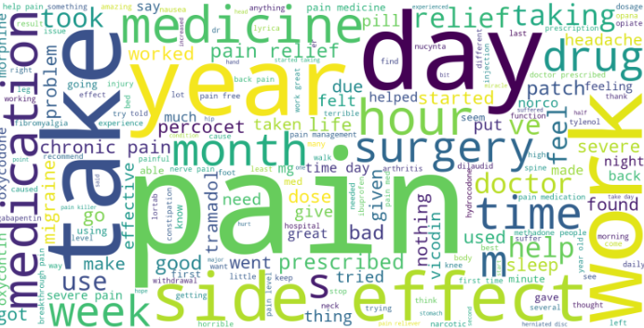
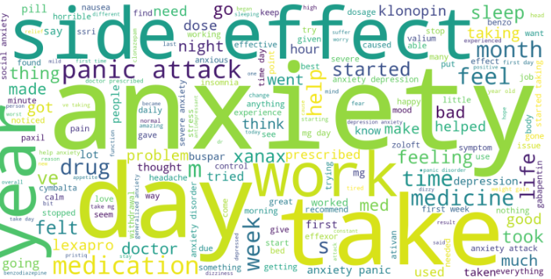
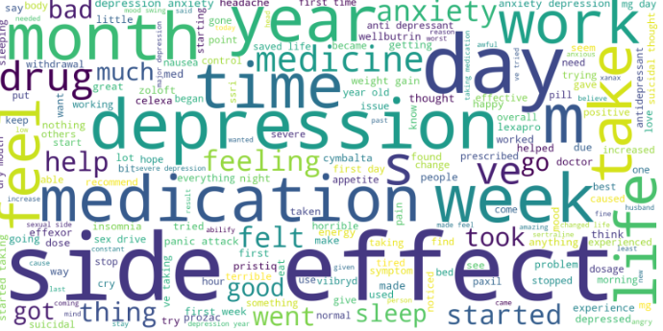
Word Clouds
Following text pre-processing, word cloud figures for:
(i) Depression ; (ii) Pain and (iii) Anxiety were analysed
6 6

Slide 7
Disease Diagnosis: Using Transformers
We employ DistilBERT, a more efficient variant of BERT which retains a lot of its performance capabilities.
Use the 12-layer base variant and fine-tune the model for condition classification task.
Training parameters:
Batch size: 16
AdamW Optimizer with with a learning rate of 2e-5 and an epsilon value of 1e-8
Epochs: 3
The data was split into a training and validation, accuracy of validation test is assessed to ensure the model generalizes well beyond the training data.
7 7

Slide 8
Disease Diagnosis: Using an LSTM Neural Network Model
Prior to utilising a deep learning model to obtain classification results, words must be represented as vectors of real numbers (Word Embedding):
Creation of word embeddings was carried out using the Word2Vec algorithm trained on text (review) in unstructured dataset.
Our Word2Vec model made use of the Continuous bag of words algorithm train word embeddings.
The word embedding created was utilised as the input layer of our neural network. The two other layers utilised were:
An LSTM layer with 64 units
A dense layer used as an output layer with a softmax activation function.
8 8

Slide 9
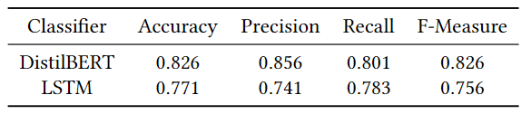
Model Evaluation
Prior to training model, dataset was split into a training (70% of data) and testing (30% of data) set.
The following metrics were utilised to evaluate model based on how well it is able to predict testing set labels (condition):
Accuracy
Macro-Average precision
Macro-Average recall
Macro-Average F1-Score
9 9

Slide 10
Knowledge Graph
The KG consists of 3 node types: Condition, Drug and Drug_Class
Drug nodes have attributes; Pregnancy Category, Controlled_Substance_Abuse_Category and Alcohol_Category.
Relationship types:
Drugs which are used to treat a condition are linked by a TREATS edge. This relationship has properties of scores and number_of_reviews which offer a quantitative measure of the drug's overall user-determined effectiveness against the condition.
Drugs belonging to a drug class are linked by a `BELONGS TO’ edge
10 10

Slide 11
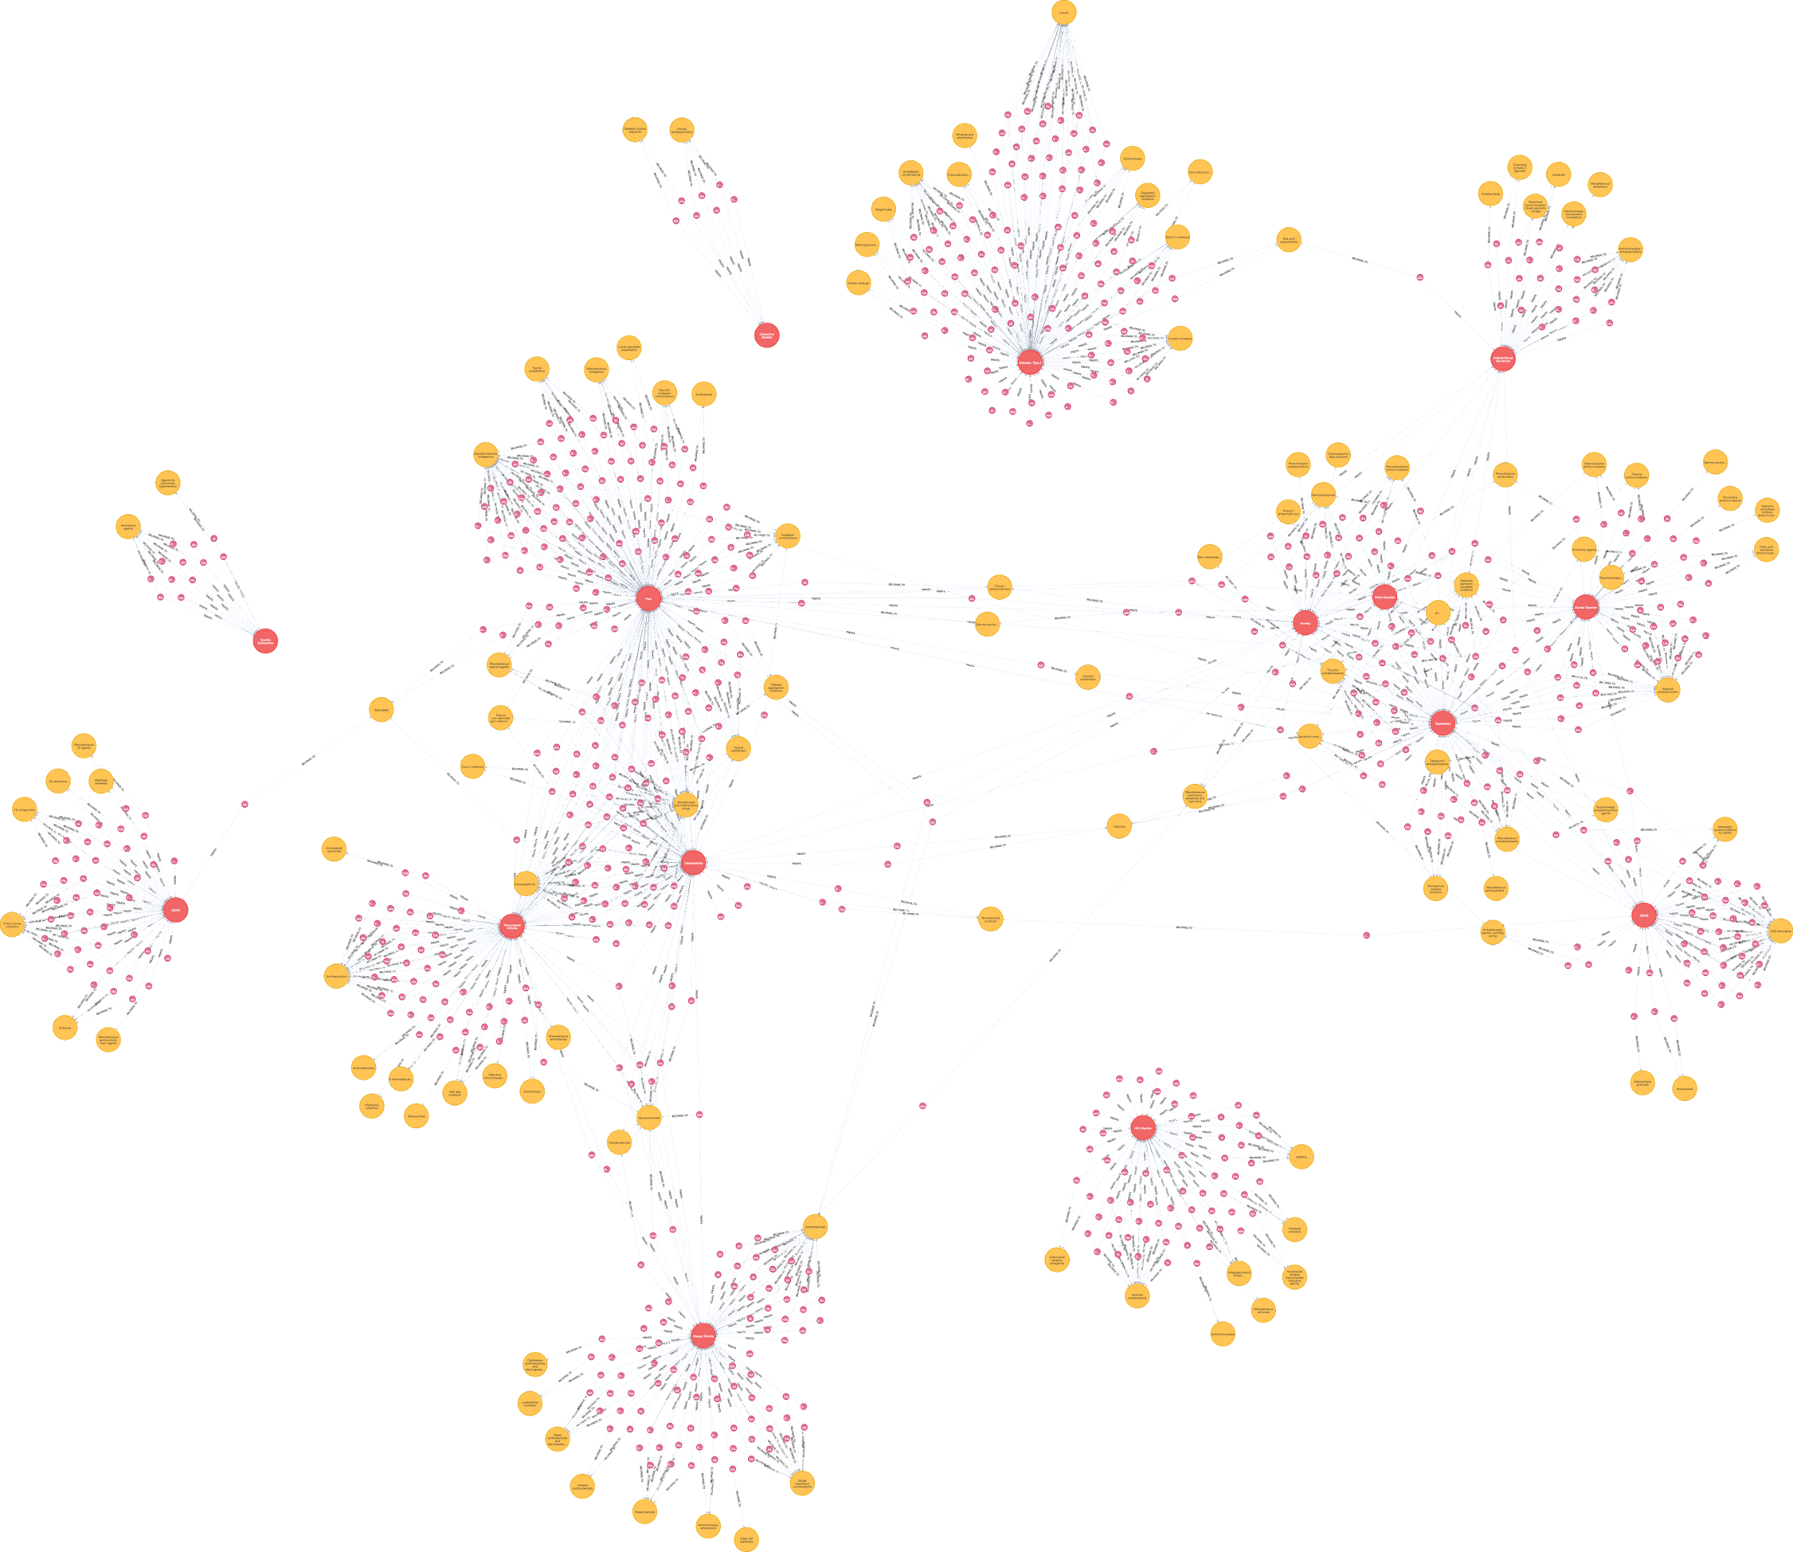
Knowledge Graph
The KG is created using Neo4j, and using the Python library py2neo to interact with the Graph DBMS.
The red nodes represent the conditions, the purple nodes represent the individual drugs, and the yellow nodes represent the drug classes.
11 10

Slide 12
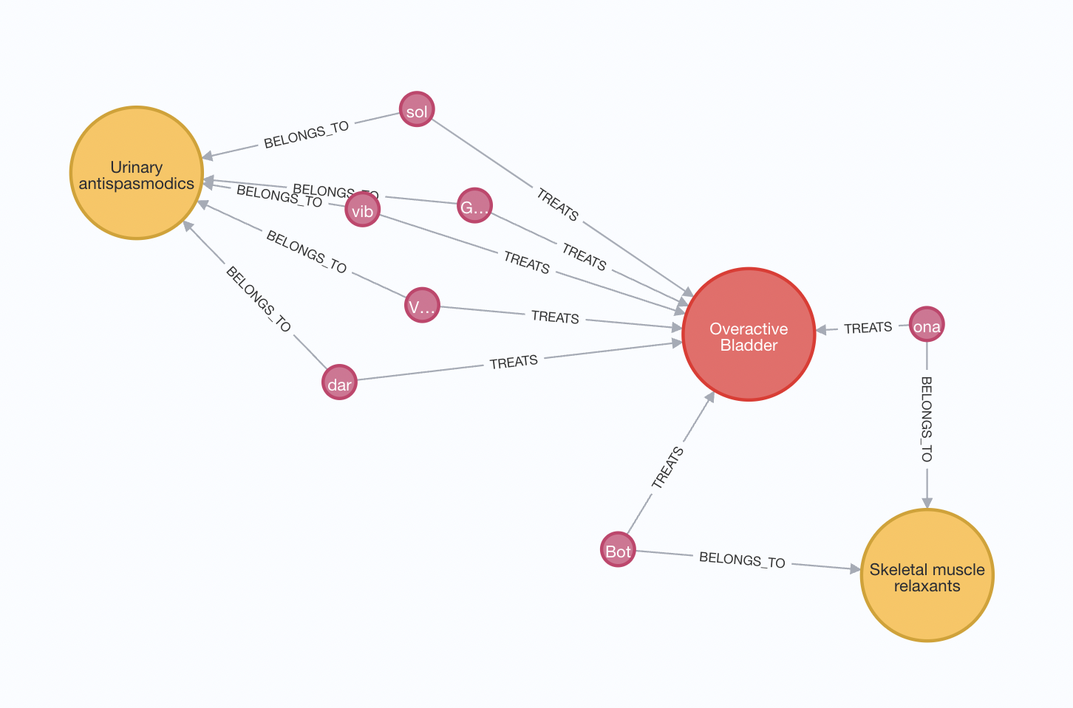
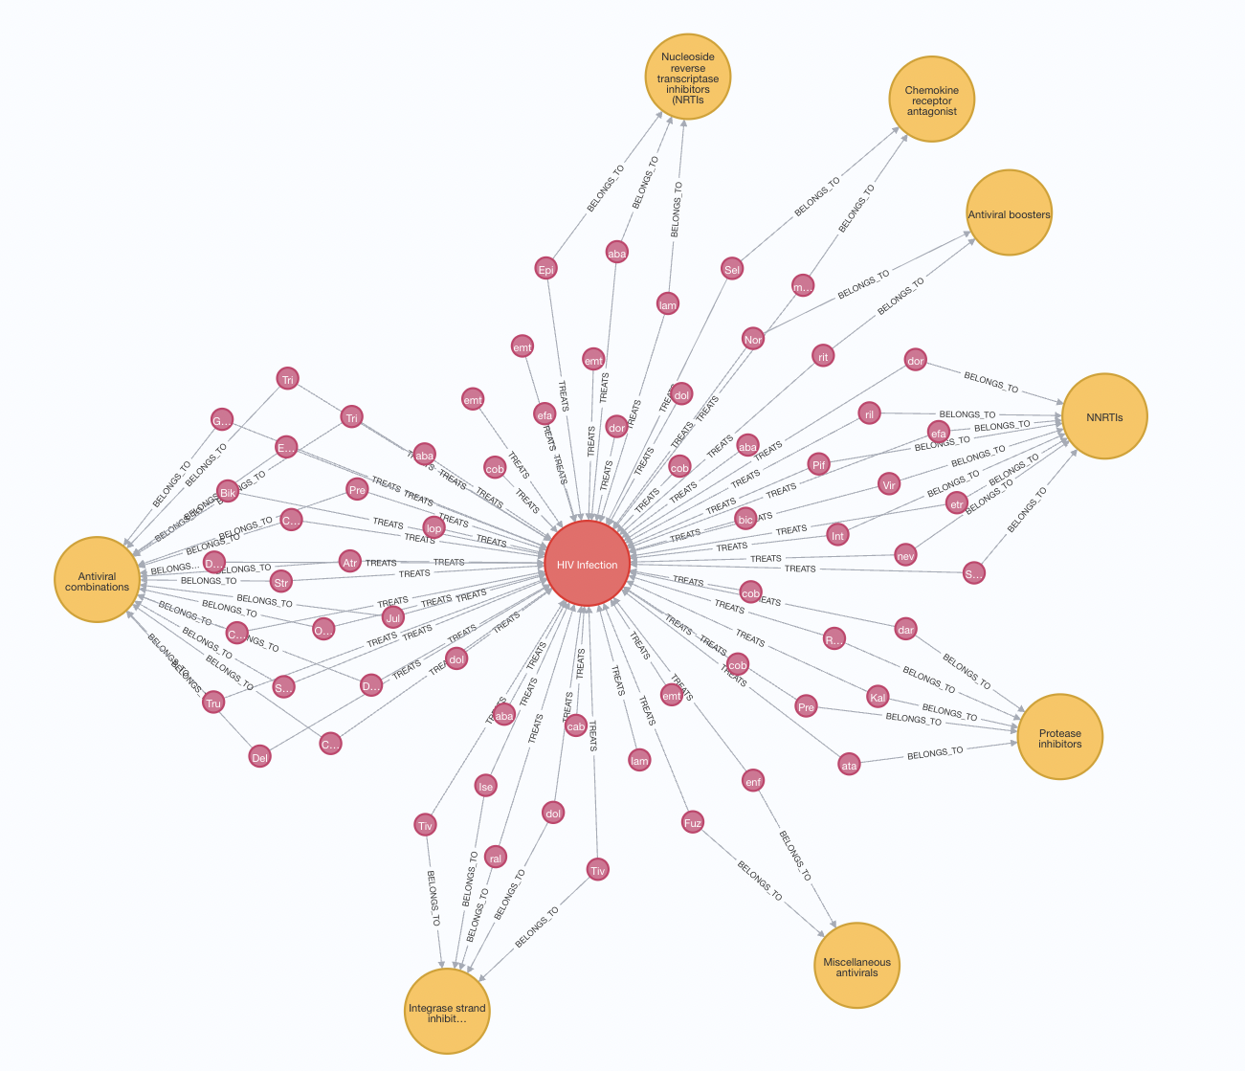
Knowledge Graph
Distinct clusters represent groups of drugs related to specific conditions.
However, some drug nodes serve as bridges between these clusters.
12 11

Slide 13
Competency Questions
Which is the highest recommended drug for a given condition?
2.1. Which drugs are unsafe for pregnant patients, for a given condition?
2.2. Which drugs have a high abuse potential, for a given condition?
2.3. Which drugs are known to interact with Alcohol, for a given condition?
3. What are the common drug classes for drugs treating a specific condition?
4. What is the highest rated drug in each Drug Class for a specific condition?
5.1. Which drugs are used to treat multiple conditions?
5.2. Which condition pairs have the highest number of shared drugs?
13 13

Slide 14
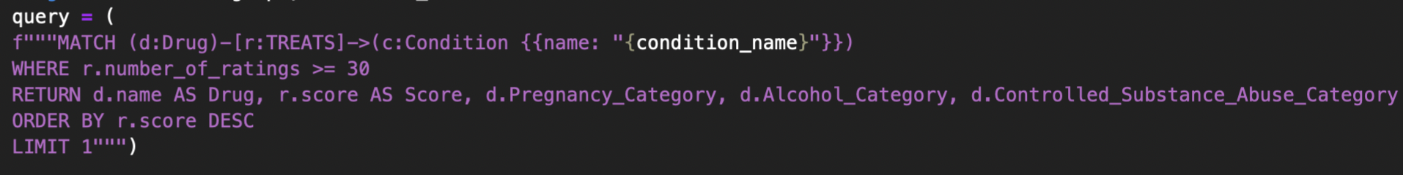
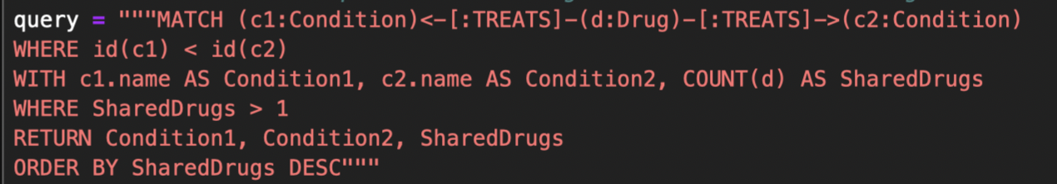
Knowledge Extraction
14 13

Slide 15
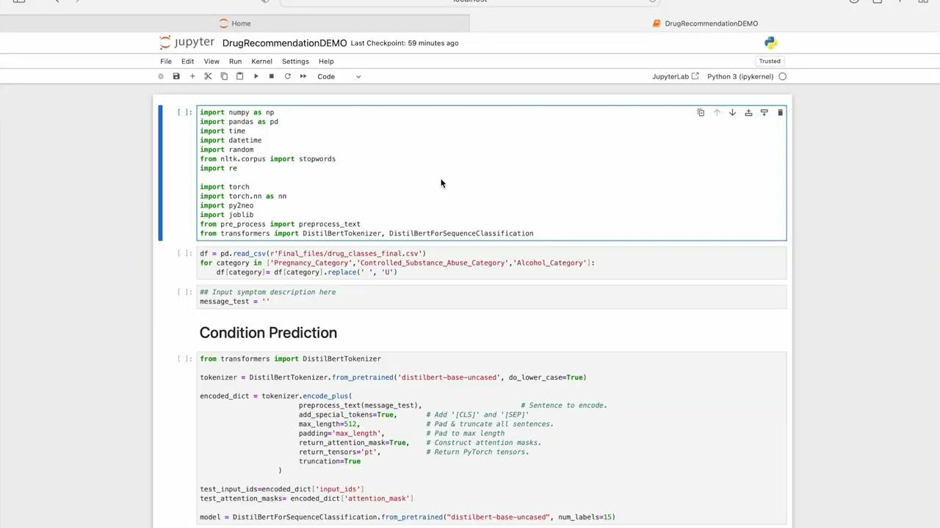
Demonstration of working solution
15 12

Slide 16
Remarks
A number of remarks can be made regarding the structured and unstructured datasets utilised:
Reviews of drugs are made by individuals who have already been diagnosed and hence are already aware of what symptoms define their condition.
Main focus of text data utilised is not a description of symptoms but on the effectiveness of the medication.
Conditions represented in unstructured dataset are imbalanced. Performance metric values could potentially be flawed.
Structured dataset consisted of limited information on each drug. Additional information such as dosage, side-effects and effectiveness would have been useful.
16 14

Slide 17
Further Research
Additional improvements which can be made to our solution are as follows:
Utilise some form of over-sampling/under-sampling technique to combat imbalance in unstructured dataset
Use a more domain-specific BERT model pre-trained on medical text
Utilise Grid-Search/Random-Search hyperparameter tuning to select optimal parameters for LSTM Neural Network model
Increase detail of knowledge graph by making use of side-effects and other drug properties
17 15

Slide 18
Thank you!

